Slide 1

Floating Point
Understand floating points
Know when computers fail
Understand floating point operations
① Fixed point representation
② Floating point representation
③ IEEE 754 standard

Slide 2
Is it true for all values of x and y:
(x>0)||(x-1<0)
(x&7)!=7||(x<<29<0)
(x*x)>=0
x<0||-x<=0
x>0||-x>=0
Int x=foo();
Int y=bar();
Notes:
False–True–False–True–False

Slide 3
Real Numbers
10²
10¹
10⁰
10⁻¹
10⁻²
100
10
1
0.1
0.01
d₂
d₁
d₀
.
d₋₁
d₋₂
1
0
2
.
1
6
Notes:
d0

Slide 4

Real Numbers
10^{m}
10^{m-1}
100
10²
10¹
10
10⁰
1
0.1
10⁻¹
0.01
10⁻²
10^{-n}
d_{m}
d_{m-1}
…
d₂
d₁
d₀
.
d₋₁
d₋₂
…
d_{-n}
1
9
…
1
0
2
.
0
1
…
6
$$d=\sum_{i=−n}^{m}{{10}^{i}×d_{i}}$$
Notes:
d0

Slide 5

Binary Representation
2^{m}
2^{m-1}
2²
2¹
2⁰
2⁻¹
2⁻²
2^{-n}
b_{m}
b_{m-1}
…
b₂
b₁
b₀
.
b₋₁
b₋₂
…
b_{-n}
1
0
…
1
0
1
.
0
1
…
1
$$b=\sum_{i=−n}^{m}{2^{i}×b_{i}}$$
Notes:
d0

Slide 6
Examples
Fractional
value
Binary
representation
Decimal
representation
1/8
0
.
0
0
1
0.125
25/16
1
.
1
0
0
1
1.5625
43/16
1
0
.
1
0
1
1
2.6875
?
?
9/8
1
?
?
.
0
0
1
1.125
1/3
0
.
(
0
1
)
0.(3)
?
?
1/10
$$b=\sum_{i=−n}^{m}{2^{i}×b_{i}}$$
0.1
Notes:
Từ công thức này, chúng ta sẽ tính được giá trị thập phân của một số nhị phân bất kì.

Slide 7
Precision
8 bits
0.0001100
16 bits
0.000110011001100
24 bits
0.00011001100110011001100
32 bits
0.0001100110011001100110011001100
1/10
0.0(0011)
0.1
Notes:
8 bits

Slide 8
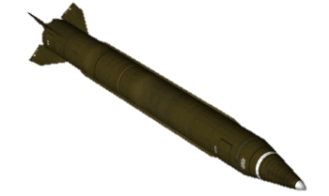
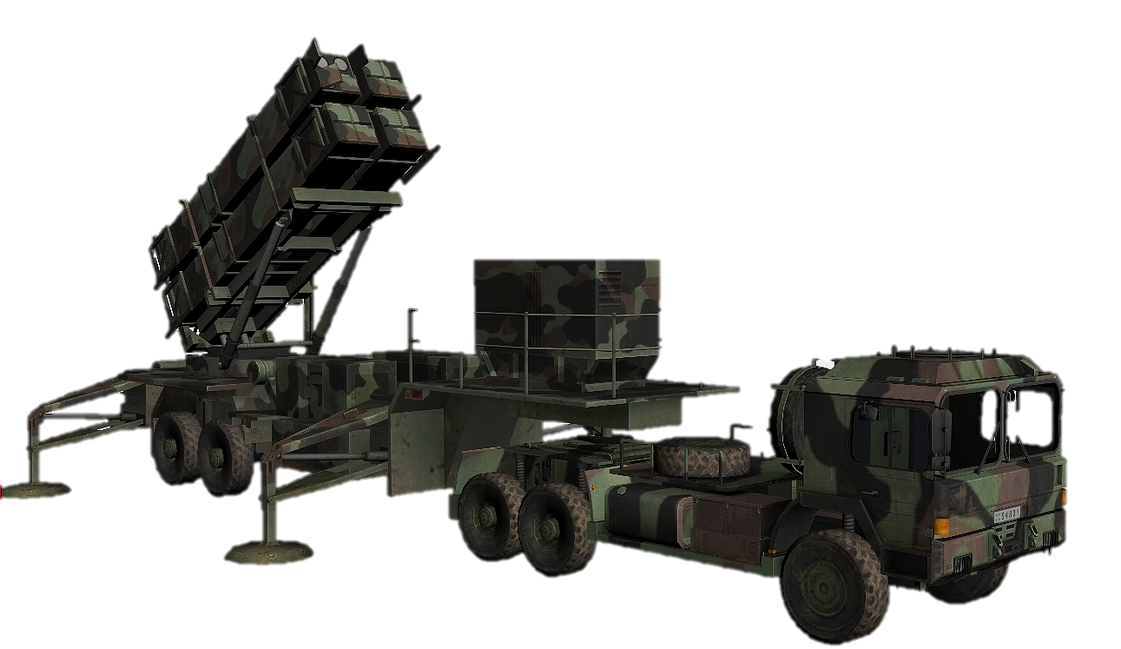

The Patriot Missile Failure
1,676m/s
×
0.34s
= 569.84 m
0.000000095s
0.00011001100110011001100
28

Slide 9
Fixed-point representation
n bits
0 0 0 0 1 1 0 0 1 1 0 0 1 1 0 0 1 1 0 0 1 1 0 0
0.00011001100110011001100
more precision
less range
middle?
more range
less precision
Notes:
k bits

Slide 10





Floating-point representation
$${ (−1)}^{S}×M×2^{E}$$
1001.1101
$→$
1.0011101×2³
0.011101
$→$
1.1101×2⁻²
-0.011101
$→$
-1×1.1101×2⁻²
Arithmetic formats
Rounding rules
Exception handling
①
②
③
④
⑤
Interchange formats
Operations
Notes:
Institute of Electrical and Electronics Engineers Viện kỹ nghệ Điện và Điện tử
arithmetic formats: sets of binary and decimal floating-point data, which consist of finite numbers (including signed zeros and subnormal numbers), infinities, and special "not a number" values (NaNs)
interchange formats: encodings (bit strings) that may be used to exchange floating-point data in an efficient and compact form
rounding rules: properties to be satisfied when rounding numbers during arithmetic and conversions
operations: arithmetic and other operations (such as trigonometric functions) on arithmetic formats
exception handling: indications of exceptional conditions (such as division by zero, overflow, etc.)

Slide 12
Normalized values
$${ (−1)}^{S}×M×2^{E}$$
exp = E + bias
bias = 2^{k-1}-1
Implied
leading 1
s
exp
frac
Notes:
Institute of Electrical and Electronics Engineers Viện kỹ nghệ Điện và Điện tử
arithmetic formats: sets of binary and decimal floating-point data, which consist of finite numbers (including signed zeros and subnormal numbers), infinities, and special "not a number" values (NaNs)
interchange formats: encodings (bit strings) that may be used to exchange floating-point data in an efficient and compact form
rounding rules: properties to be satisfied when rounding numbers during arithmetic and conversions
operations: arithmetic and other operations (such as trigonometric functions) on arithmetic formats
exception handling: indications of exceptional conditions (such as division by zero, overflow, etc.)

Slide 13
Precision options
Single precision: 32 bits
s
exp
frac
1
8 bits
23 bits
Double precision: 64 bits
s
exp
frac
1
11 bits
52 bits

Slide 14
Example
Single precision: 32 bits
s
0
exp
10001100
frac
11011011011010000000000
10001100₂
1.11011011011010000000000₂
exp = E + bias
exp = 13 + 127
1.1101101101101₂
1.1101101101101₂ × 2¹³
15213.0₁₀
11101101101101₂
Notes:
15213.0

Slide 15
Example 2
Single precision: 32 bits
s
1
exp
01111110
frac
01000000000000000000000
01111110₂
1. 01000000000000000000000₂
exp = -1 + 127
1. 01₂
-1.01₂ × 2⁻¹
-0.625₁₀
-0.101₂
Notes:
15213.0

Slide 16
Denormalized Values
0.0 ??
-0.0 and +0.0
s
000…00
all zeros
E = 1 - bias
Implied leading 0
Gradual underflow (closest to 0.0)
s
000…00
not all zeros
Notes:
15213.0

Slide 17
Special Values
-∞ and +∞
s
1 1 1 …1 1
all zeros
NaN (Not a Number)
s
1 1 1 …1 1
not all zeros
Notes:
15213.0

Slide 18
Summary
Fixed-point representation
Floating-point representation

Slide 19


James Gosling
Java Inventor
95% of the folks out there are completely clueless about floating-point.
Notes:
Someinterestingfactsaboutwhatthesevarious-sizedbytescanstore:1bit:abinarydecision1byte:acharacter5Megabytes:ThecompleteworksofShakespeare2Gigabytes:20metersofshelvedbooks10Terabytes:TheprintedcollectionoftheUSLibraryofCongress200Petabytes:Allprintedmaterialinthewholeword.5Exabytes:Allwordseverspokenbyhumanbeings
Themostcommonlyacceptedexplanationisthatourbase-10numbersystemwasadoptedbyourancestorsmostlikelybecausewehave10fingers.Interestinglyenough,maybethatiswhydigitinEnglishalsomeansafingerortoe.

